Slide 1
Creative and Innovative Project-CS6611
Topic:Data Security using Hybrid Cryptography and Steganography
Presented By:
G Vignesh
Dhamodharan S
RaghuRaj S V

Slide 2
Overall Objective:
The main objective of this project is to build a Hybrid Crypto-system that secures data on multiple layers and also ensures security of keys.
The Hybrid cryptosystem also securely stores the keys so that they don’t lead to any vulnerabilities.
To create a crypto-system that provides excellent security without compromising on performance and speed.
To overcome the performance-security tradeoffs of cryptographic algorithms when used separately.

Slide 3
Introduction:
The widen handling of digital media for information transmission through secure and unsecured channels exposes messages sent via networks to intruders or third parties. Encryption of messages in this modern age of technology becomes necessary for ensuring that data sent via communications channels become protected and made difficult for deciphering. Enormous number of transfer of data and information takes place through internet, which is considered to be most efficient though it’s definitely a public access medium. Therefore to counterpart this weakness, many researchers have come up with efficient algorithms to encrypt this information from plain text into ciphers. In information security, encryption is the process of transforming information using an algorithm to make it unreadable to anyone except those possessing special knowledge, usually referred to as a key. The result of the process is encrypted information. The reverse process is referred to as decryption. Single cryptosystems are now a days cracked with latest hardware capabilities so a hybrid system is proposed in this paper.

Slide 4
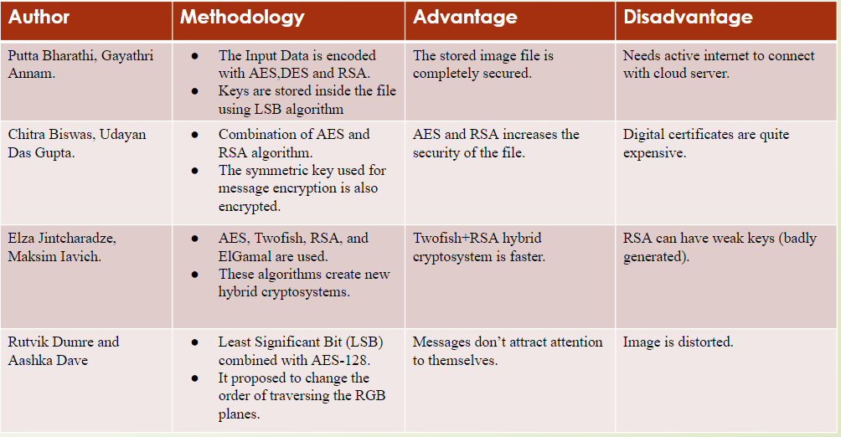
Literature Survey:

Slide 5
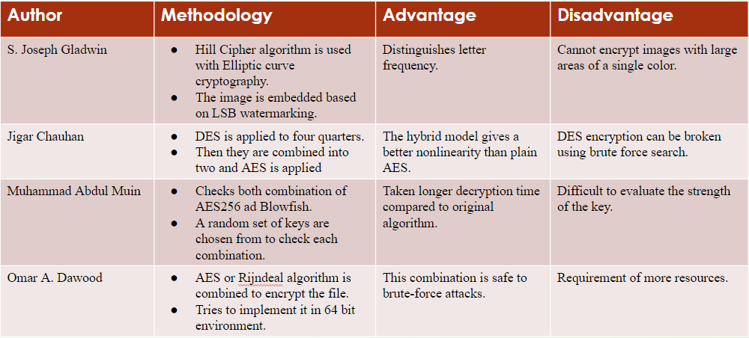

Slide 6
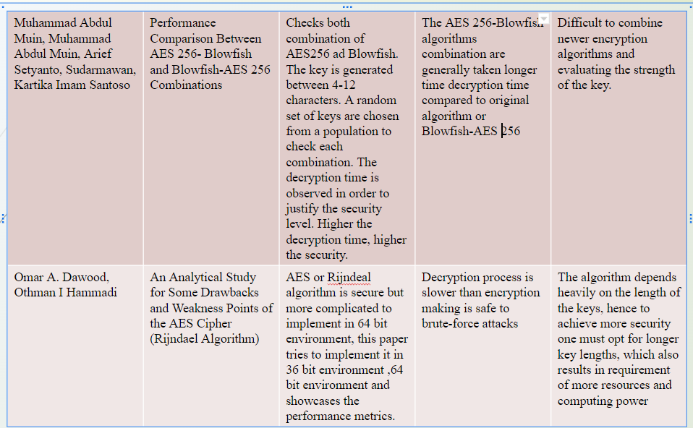

Slide 7
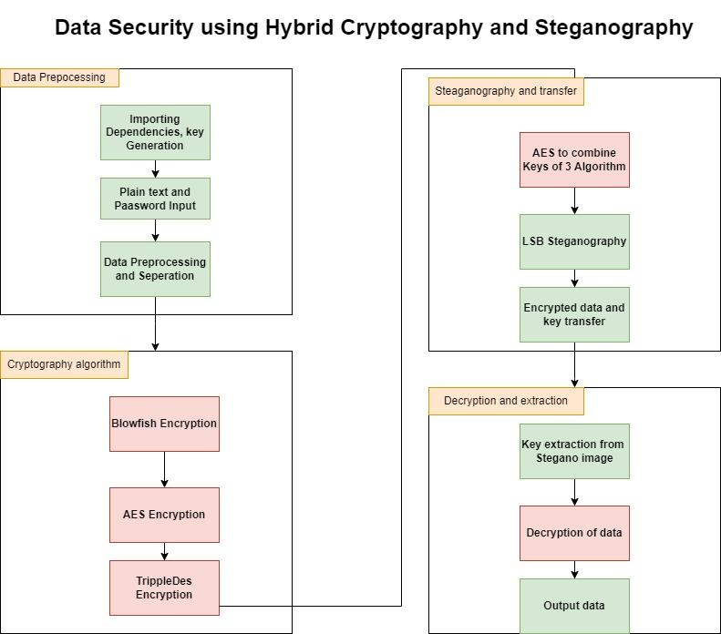

Slide 8
Modules:
Data Preprocessing
Cryptography Algorithm
Steganography and Key Transfer
Decryption and Extraction

Slide 9
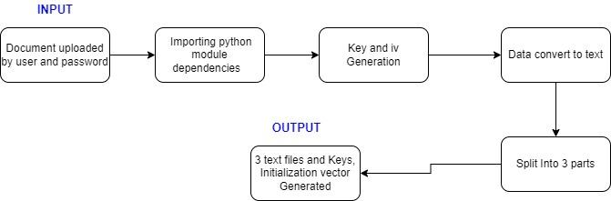
Module-1)
Data Preprocessing:

Slide 10
Description and deliverables:
Data to be sent in encrypted manner is received from the user along the key/password going to be used to encryption.
The data given the user in any format such as pdf or word is converted to a text sequence enabling us to make encryption.
Key generation block is used to generate random keys for the cryptography algorithm , which is generally 16 bit long.
Input: File to encrypted, password.
Output: Processed text sequence and Keys for cryptography algorithm.

Slide 11
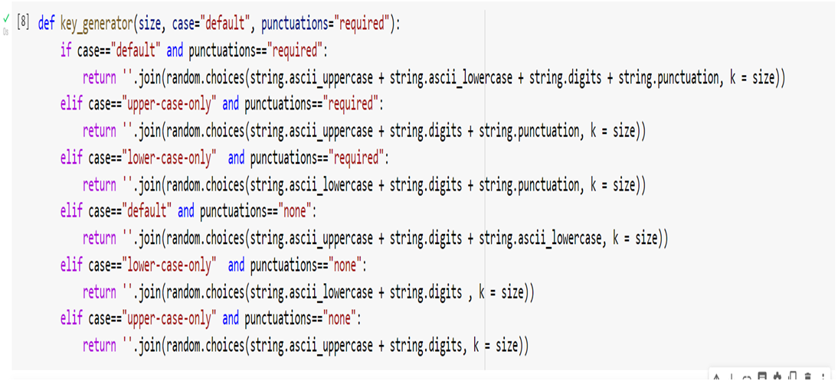
Pseudo code
Key generation:

Slide 12
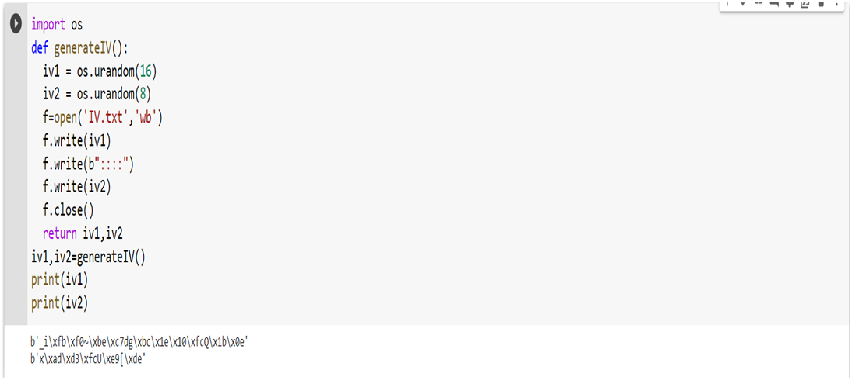
Initialization vector generation:

Slide 13
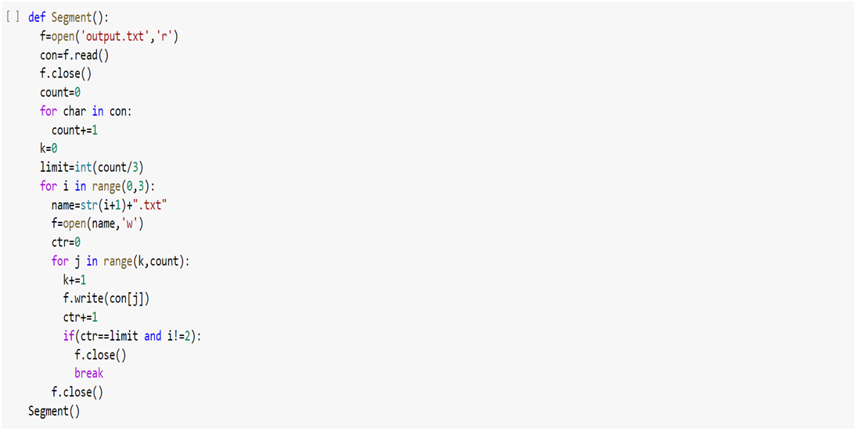
Segmentation of document:

Slide 14
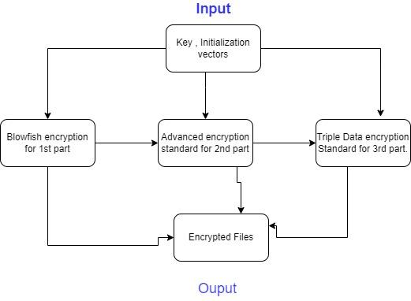
Module-2)
Cryptography Algorithm:

Slide 15
Description and deliverables:
Three Cryptography algorithm such as blow fish, AES,Triple DES are implemented in this module in a for each part of the document separately
First the text sequence is applied to BlowFish algorithm along with the generated key and Initialization vector to obtain a cipher text.
Similarly AES and TripleDES applied along with their keys and IV’s for 2nd and 3rd part of text document and corresponding Encrypted files are obtained.
Input: Text sequence of 3 parts, keys and Initialization vectors
Output: Encrypted files-cipher text.

Slide 16
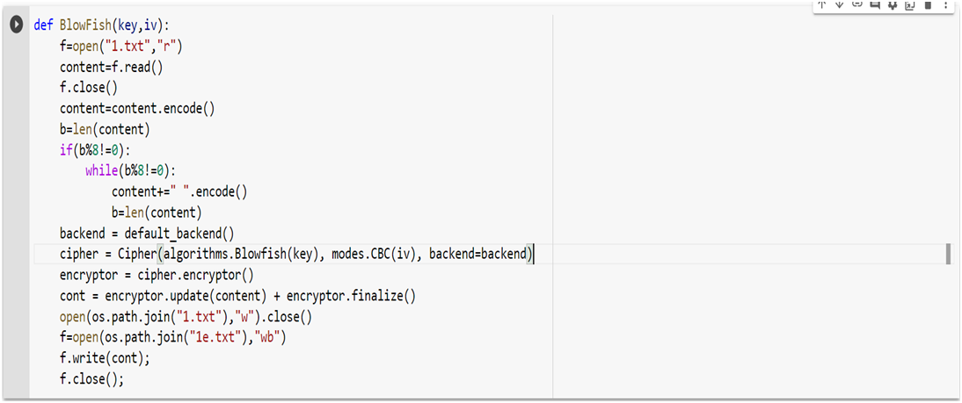
Pseudo code:
Blowfish

Slide 17
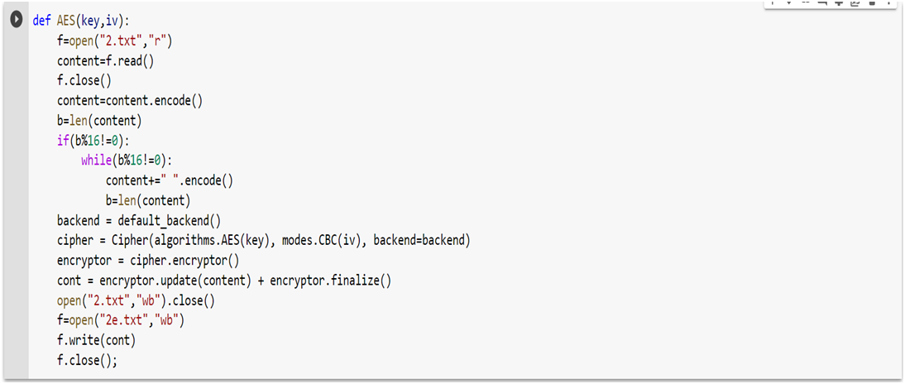
Advanced Encryption Standard:

Slide 18
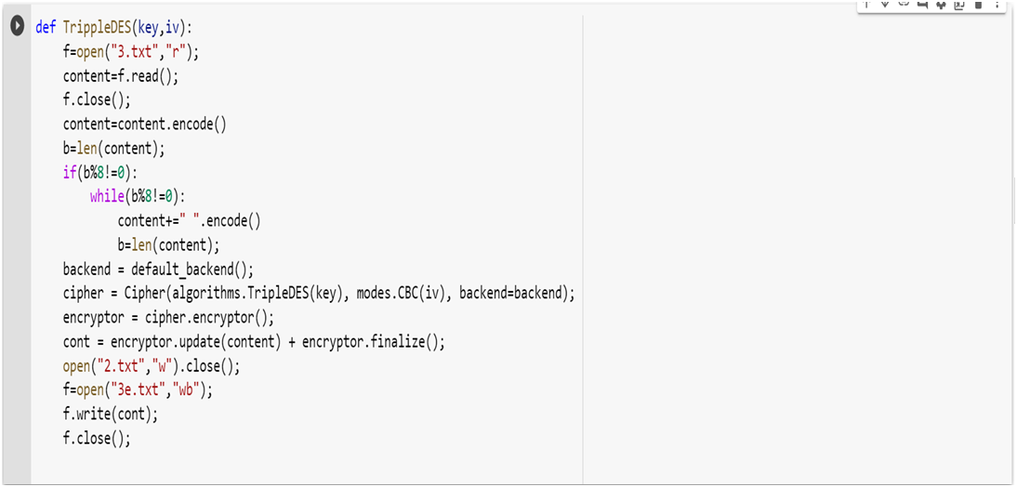
Triple Data encryption Standard

Slide 19
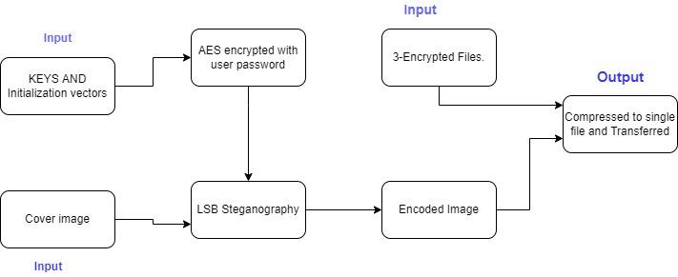
Module-3)
Steganography and Key transfer

Slide 20
Description and Deliverables:
Least significant bit steganography technique is used to with a selected cover image.
The keys and initialization vectors used in crypto-algorithms are combined using AES algorithm by password obtained from the user and hidden in the image using a cover image PNG file
The stegano-image where the keys are hidden in the least significant bit of the image along with the encrypted file is compressed into a single file send to the receiver in email.
Input: Encrypted files, keys,IV vector,Image.
Output: Compressed ZIP file-Enc files and encoded image.

Slide 21
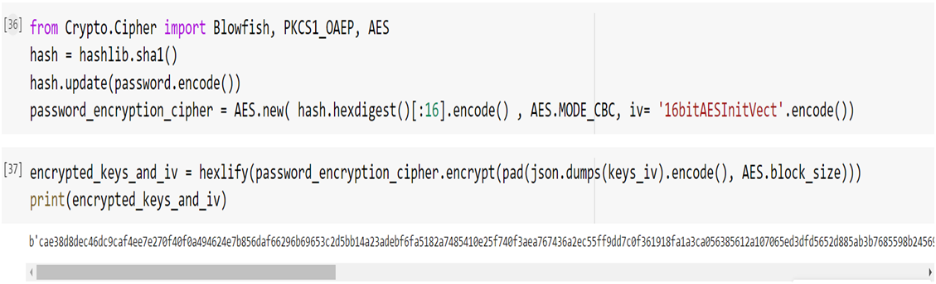
Pseudo Code:
AES encryption of keys

Slide 22
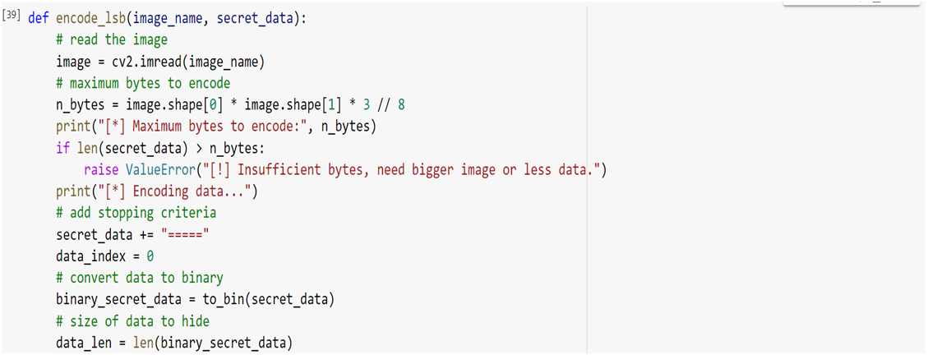
Lsb steganography:

Slide 23
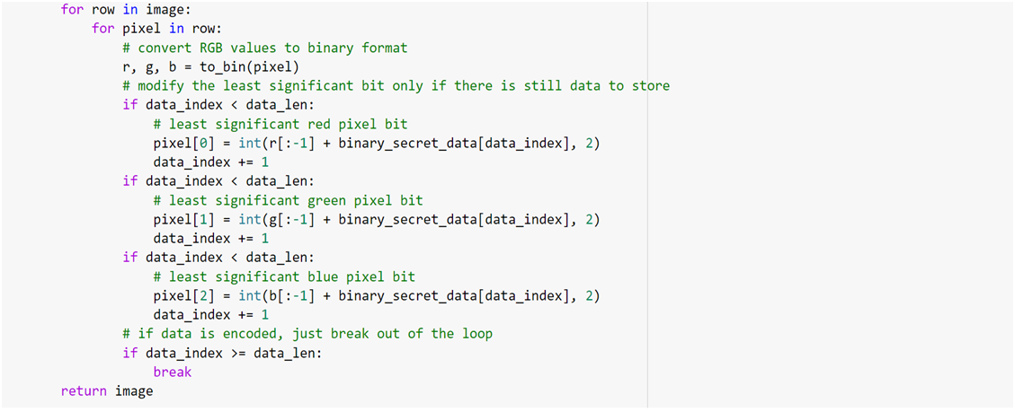

Slide 24
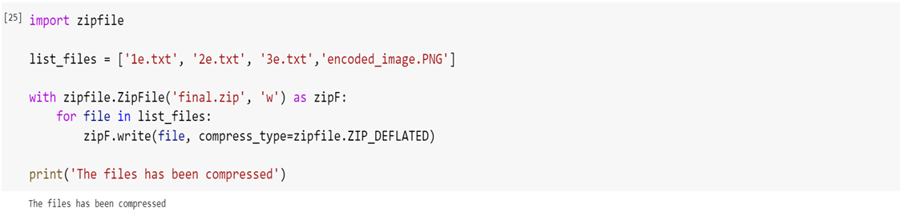
Compression of encrypted Files and Images:

Slide 25
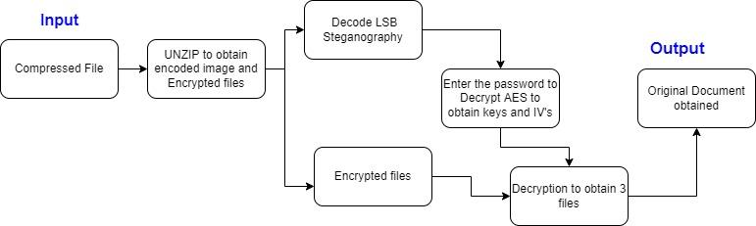
Module-4)
Decryption and Extraction:

Slide 26
Description and Deliverables:
The compressed File is unzipped to obtain encoded stegano image and Encrypted files.
The Stegano-image received is decrypted using AES Decryption with the password to obtain the combined keys.
The keys are separated and given to encrypted files of Blowfish,AES AND TripleDES separately to decrypt the file into 3 parts.
The Decrypted files are merged to Obtain the original document
Input: Compressed File-containing encoded image and encrypted file.
Output: decrypted original file.

Slide 27
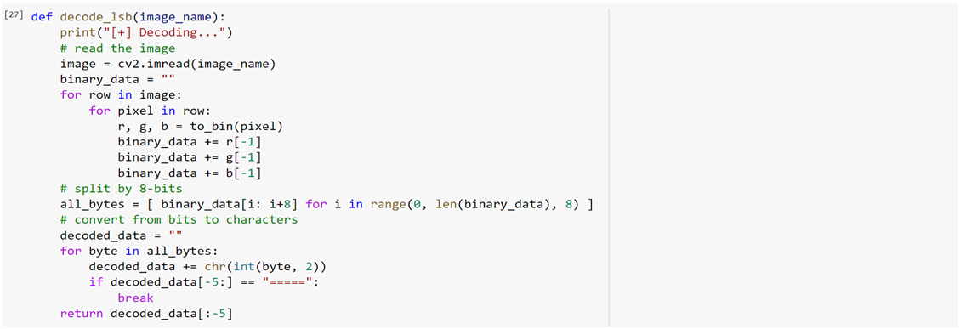
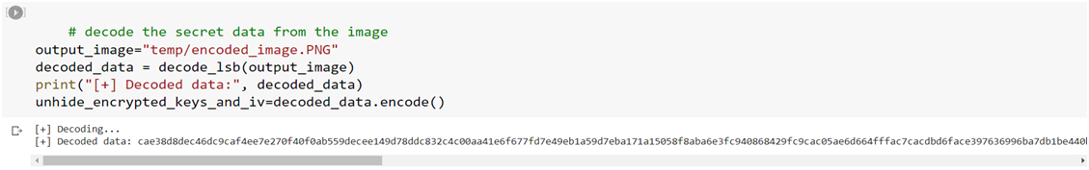
Pseudo code:
Obtain keys from stegano-image:

Slide 28
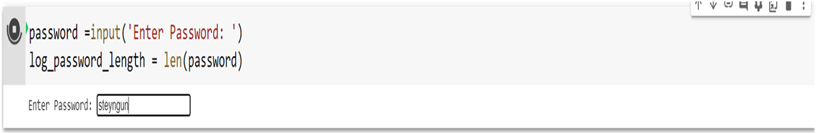
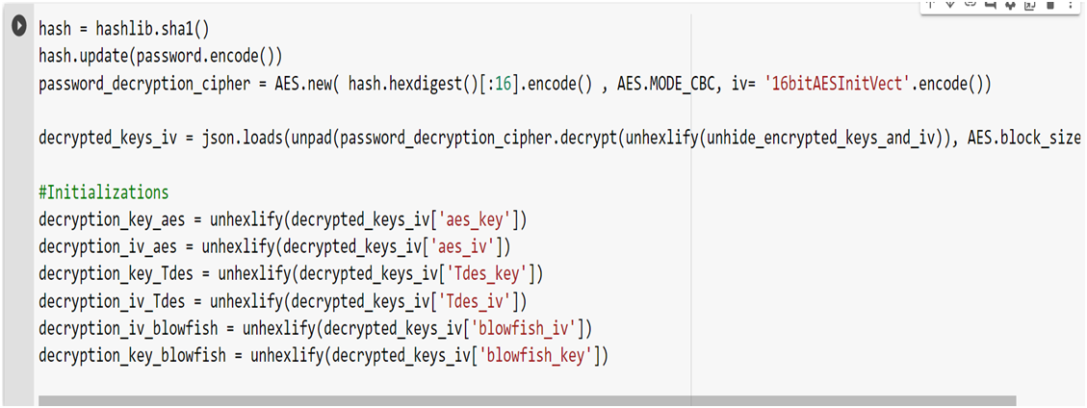
AES Decryption to obtain Individual keys:

Slide 29
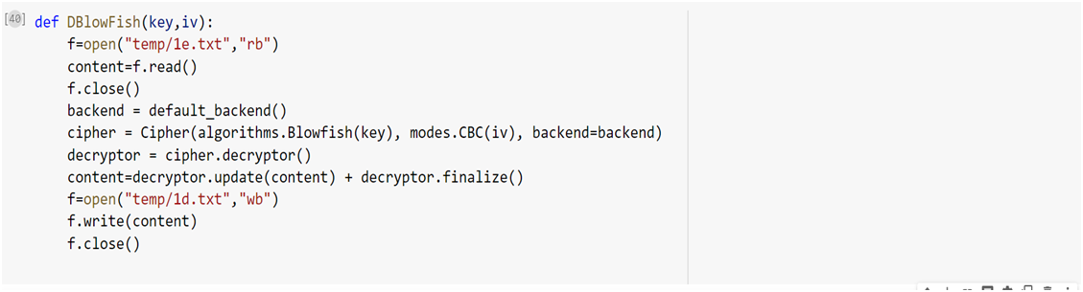
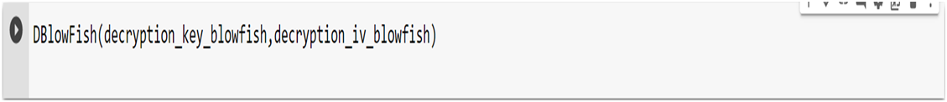
Decryption of data-eg:Blowfish

Slide 30
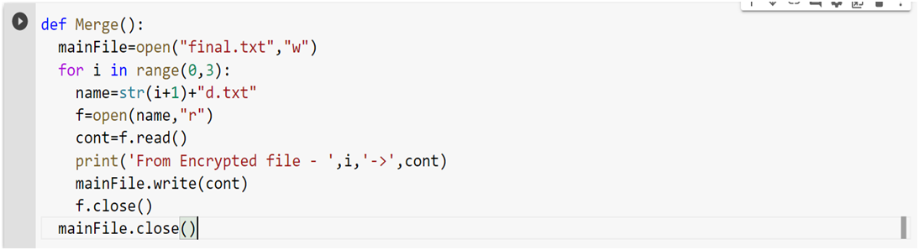
Merging of Cipher text

Slide 31
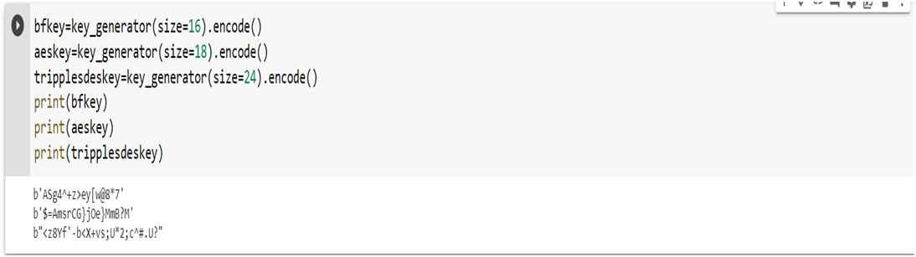
Implementation:
Key and Initial Vector Generation:

Slide 32
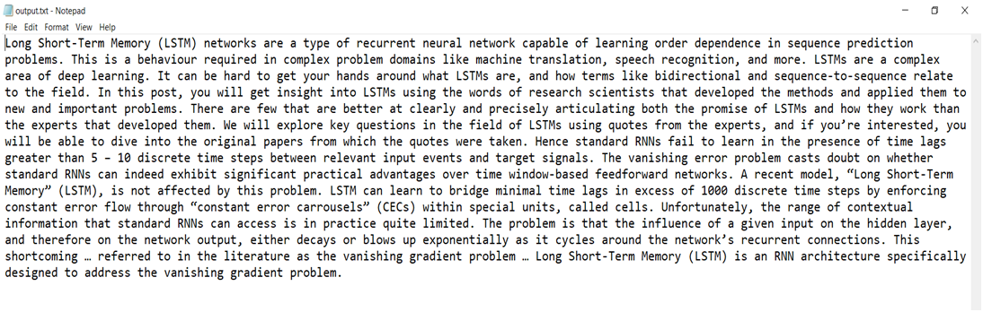
Data Segmentation:
Data converted to text format:

Slide 33
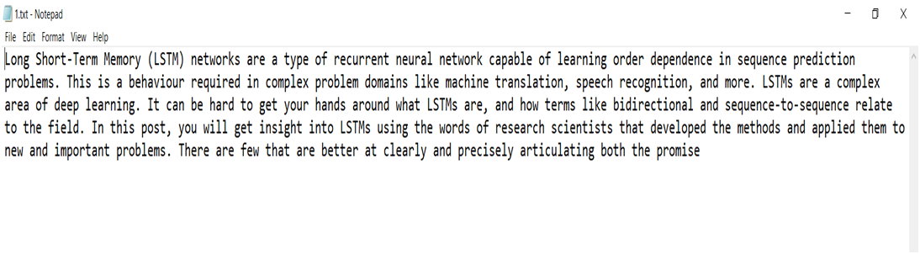
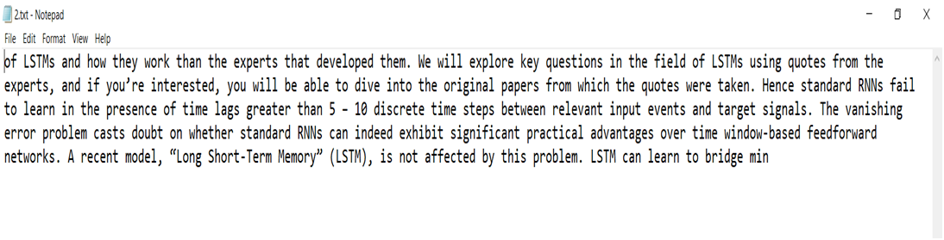
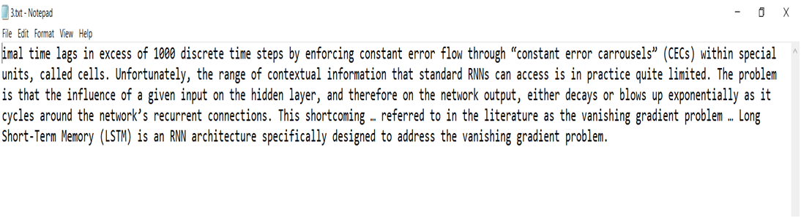
Splitted to 3 parts

Slide 34
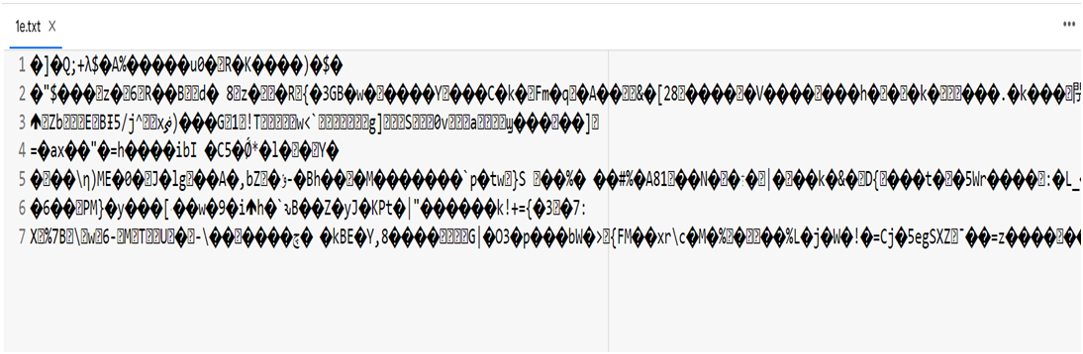
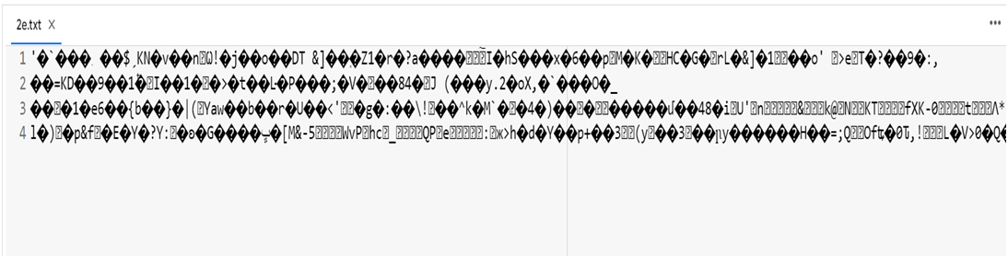
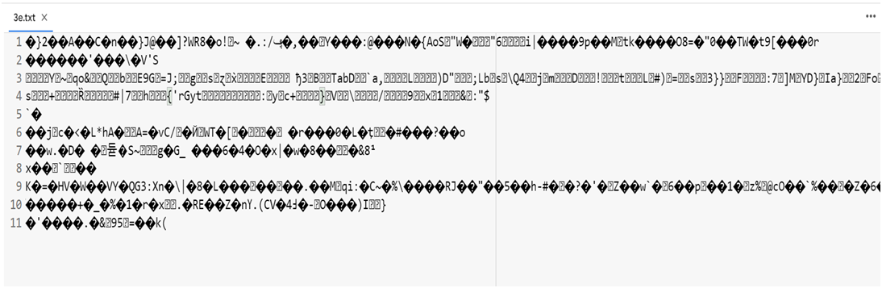
Blowfish encryption:
Advanced Encryption standard Encryption:
Triple Data encryption Standard Encryption:

Slide 35
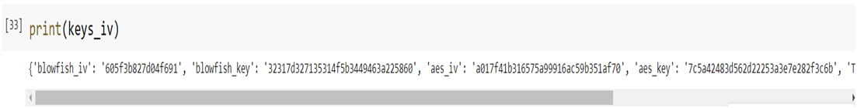
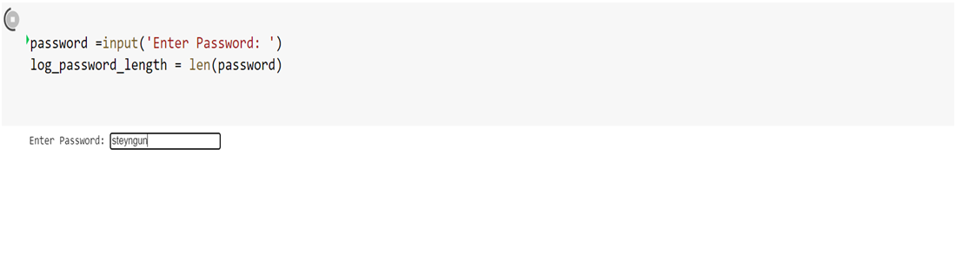

Keys used are combined
Keys are Encrypted Using user Password Via AES:

Slide 36
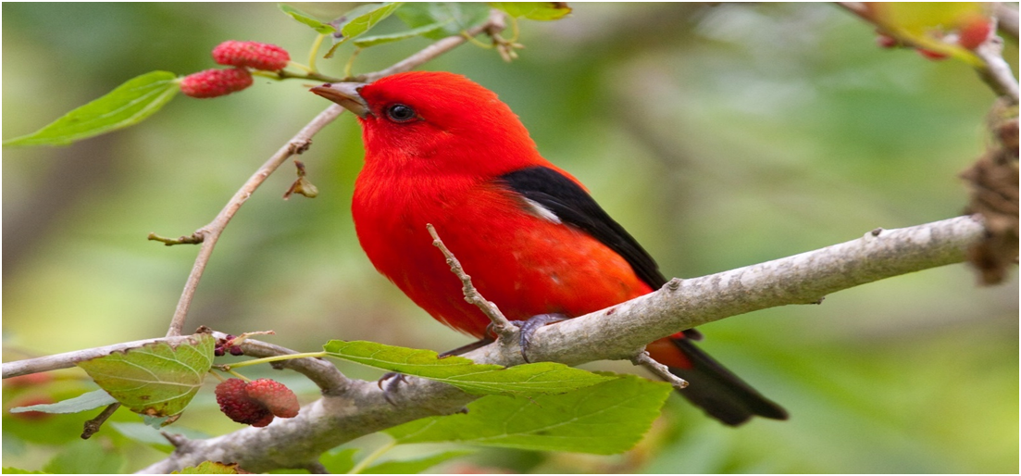
Lsb Steganography:
Keys are Encoded inside the Image into their Least Significant bit

Slide 37
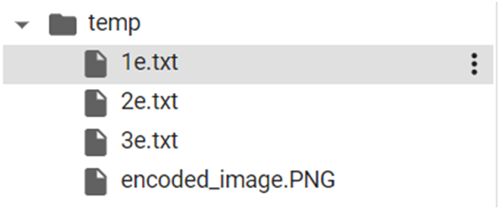
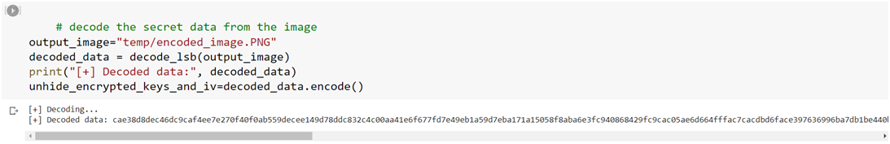
Compress and Transfer:
The encrypted files and Encoded images are compressed into a zip file and transfer to receiver.
Reverse steganography is done to obtain the data hidden in the image.

Slide 38


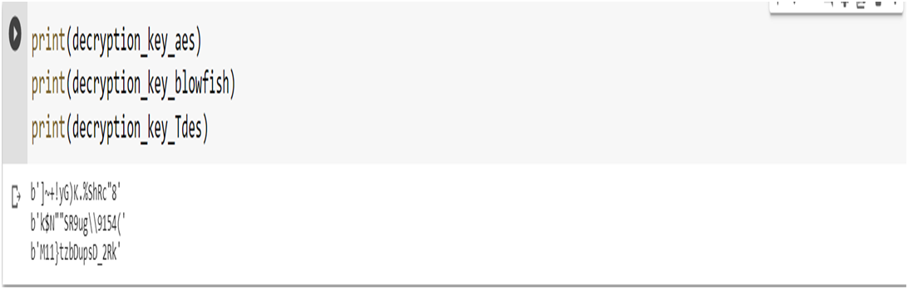
Password is entered to AES algorithm to Decrypt the key and IV vectors f=obtained from Image:
Keys and iv obtained are printed here:

Slide 39
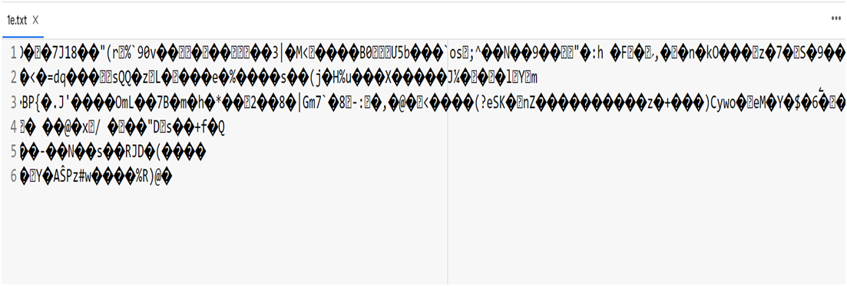
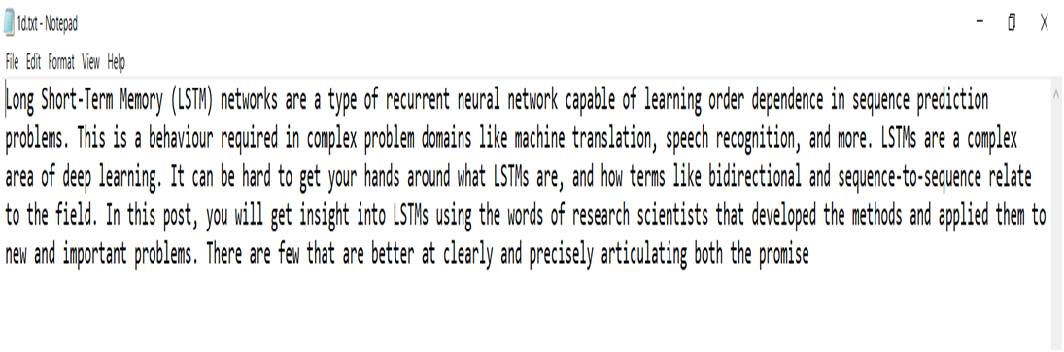
Decryption of blowfish:

Slide 40
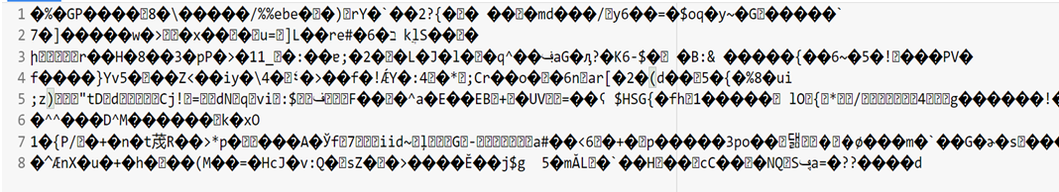
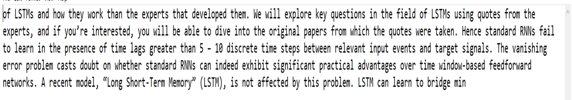
Decryption of AES:

Slide 41
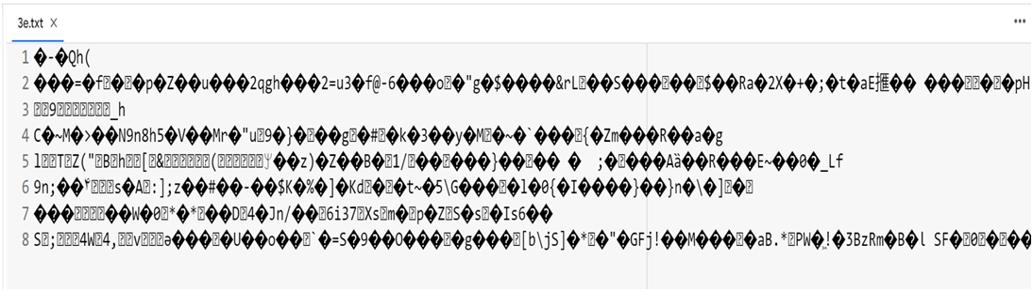
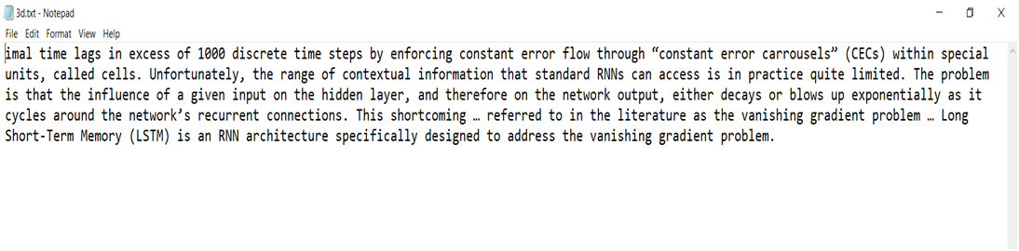
Decryption of TripleDES:

Slide 42
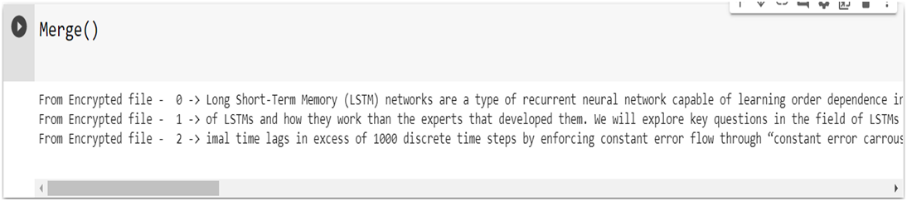
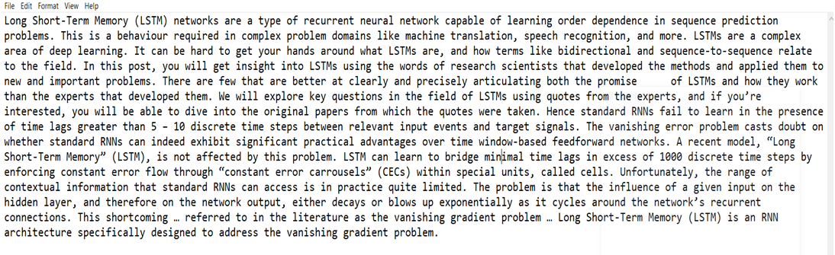
Output data:
Original data is obtained by merging the decrypted data

Slide 43
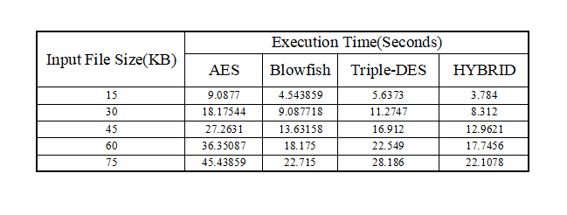
Performance metrics:
The metrics that are selected for the evaluation are encryption time, decryption time, throughput of encryption, throughput of decryption, diffusion analysis, CPU process time, and CPU clock cycles, power consumption and memory utilization.Here Encryption time is used to measure with existing system and hybrid system.

Slide 44
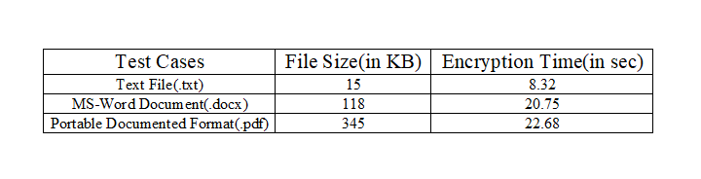
Test cases:
Files of different sizes and types were encrypted using the proposed system with the same password, for every file.

Slide 45
References:
1.Secure File Storage Using Hybrid Cryptography:
2021 6th International Conference on Communication and Electronics Systems (ICCES)
Authors: Putta Bharathi, Gayathri Annam, Jaya Bindu, Kandi Vamsi, Krishna Duggana and Anjali.T
2.An Efficient Algorithm for Confidentiality, Integrity and Authentication Using Hybrid Cryptography and Steganography 2019 :
International Conference on Electrical, Computer and Communication Engineering ( ECCE), 7­9 February, 2019
Authors: Chitra Biswas, Udayan Das Gupta and Md. Mokammel Haque
3.Hybrid Implementation of Twofish, AES, ElGamal and RSA Cryptosystems:
2020 IEEE East­West Design &amp; Test Symposium (EWDTS)
Authors: Elza Jintcharadze Maksim Iavich
4. Exploring LSB Steganography Possibilities in RGB Images:
2021 12th International Conference on Computing Communication and Networking
Technologies
Authors: Rutvik Dumre and Aashka Dave

Slide 46
5.Combined Cryptography and Steganography for Enhanced Security in Suboptimal Images: 2020 International Conference on Artificial Intelligence and Signal Processing (AISP)
AUTHORS:S. Joseph Gladwin and Pasumarthi Lakshmi Gowthami
6.Enhancing Data Security by using Hybrid Cryptographic Algorithm
Authors, Publication & Year: Jigar Chauhan, Neekhil Dedhia, BhagyashriKulkarni ‐ IJESIT, 2013
7.Performance Comparison Between AES 256‐Blowfish and Blowfish‐AES 256 Combinations
Authors, Publication & Year:Muhammad Abdul Muin, Muhammad Abdul Muin, Arief Setyanto, Sudarmawan, Kartika Imam Santoso ‐ ICITACEE,2018
8 .An Analytical Study for Some Drawbacks and Weakness Points of the AES Cipher (Rijndael Algorithm) The 1st International Conference on Information Technology (ICoIT'17) At Lebanese French University Erbil, Kurdistan Region – Iraq 10th April, 2017 Authors: Omar A. Dawood, Othman I Hammadi

Slide 47
Thank You!!!

